Slide 1

A+ Guide to Managing and Maintaining your PC, 6e
Chapter 12
Maintaining Windows 2000/XP

Slide 2
Objectives
Learn how to install and manage hardware and applications using Windows 2000/XP
Learn how to protect and maintain Windows 2000/XP system files
Learn about the Windows 2000/XP registry
Learn how to optimize the Windows 2000/XP environment for best performance

Slide 3
Introduction
Topics to cover:
Installing and supporting hardware
Installing and supporting applications
Protecting and maintaining Windows system files
Optimizing the OS
Windows registry

Slide 4
Supporting Hardware and Applications
Hard drives are installed in a unique way
Things to learn:
Special tools and methods used to install hard drives
How to troubleshoot problems with a hardware device
Installing applications, including legacy applications
Monitoring and managing hardware and applications

Slide 5
Installing Hardware and Applications
Administrator privileges needed for most installations
Any user can install device under certain conditions:
Device drivers can be installed without user input
All files necessary for complete installation are present
The drivers have been digitally signed
There are no errors during installation
Recommendation: use drivers written for the OS
Drivers are usually on CDs bundled with the device
Manufacturer’s Web site is a source of drivers
Other sites have drivers; e.g., www.driverzone.com

Slide 6
Installing Hardware and Applications (continued)
General directions for installing a hardware device
Download driver files to your hard drive (if necessary)
Determine if driver should be installed before device
If driver needs to be installed first, run setup program
Steps to install a hardware device using Windows XP
If device installed first, plug in device and turn on PC
After Wizard appears, pick automatic driver installation
Instruct Wizard to locate and install drivers
Check for errors and then test the device

Slide 7
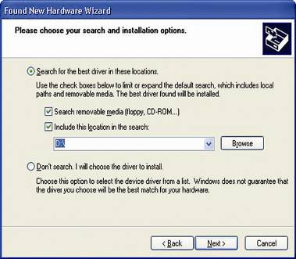
Figure 12-5 The Found New Hardware Wizard asks for directions to locate driver files

Slide 8
Installing Hardware and Applications (continued)
XP may automatically install a Microsoft driver
Prevent this action by running setup program
After the fact, use Device Manager to update driver
Steps to install a device using Windows 2000
Run the setup CD or physically install the device
The Found New Hardware Wizard dialog appears
Choose whether to search for a device or display a list
If necessary, specify a search location
Allow Windows 2000 to complete the installation

Slide 9
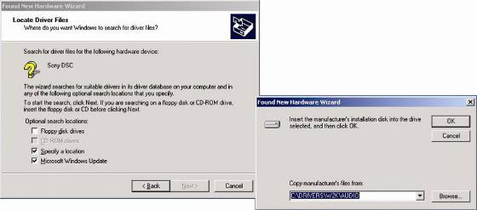
Figure 12-10 Point to the location of driver files for a new device

Slide 10
Preparing a Hard Drive for First Use
OS tools to partition and format a hard drive:
During installation: use Windows setup program
Programs to use after installation:
Disk Management, Windows Explorer, Diskpart, Format
Third-party software can be used; e.g., PartitionMagic
Reasons to partition and format a hard drive:
Preparation for first time use (required)
To overwrite an existing partition that is error-prone
Backup a drive that is infected with a virus
Wipe a hard drive clean and install a new OS

Slide 11
Preparing a Hard Drive for First Use (continued)
Disk Management graphical user interface:
Used to create partitions and format logical drives
Can create volumes on dynamic disks
Can also convert a basic disk to a dynamic disk
Two ways to access the Disk Management utility
Control Panel →Administrative Tools→Computer Management→Disk Management
Enter Diskmgmt.msc in Run dialog box

Slide 12
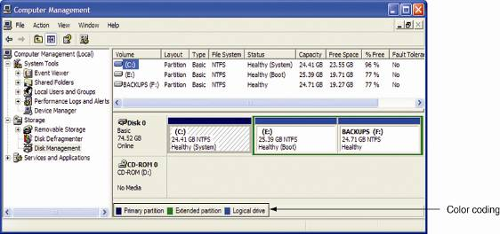
Figure 12-14 This one hard drive has three partitions

Slide 13
Preparing a Hard Drive for First Use (continued)
Partitioning and formatting with Disk Management
After opening utility, right-click a new drive
Select New Partition to launch New Partition Wizard
Choose Primary partition and then click Next
Allocate space for the partition
Choose drive letter, file system, and volume name
Test the new drive by creating and using a folder

Slide 14
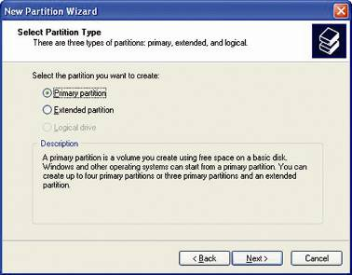
Figure 12-16 The first partition on a hard drive should be the primary partition

Slide 15
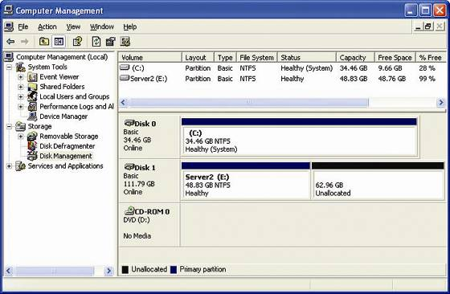
Figure 12-17 One partition created and formatted on the new hard drive

Slide 16
Solving Hardware Problems Using Windows 2000/XP
Preparatory steps
Question the user
Identify recent changes to the system
Make an initial determination of the problem
Document symptoms, actions taken, and outcome
Some corrective measures
Try a simple reboot
Uninstall the device, reboot and reinstall drivers
Update device drivers
Return to an earlier restore point

Slide 17
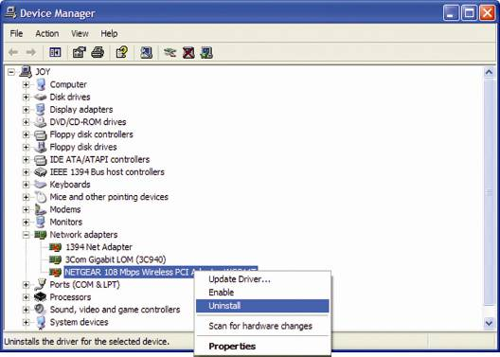
Figure 12-18 Use Device Manager to uninstall a device

Slide 18
Solving Hardware Problems Using Windows 2000/XP (continued)
Updating drivers
Locate the drivers or download them from the Web
Right-click device in Device Manager, select Properties
Select Driver tab and click Update Driver
Respond to queries of Hardware Update Wizard
Roll Back Driver
Feature that enables you to revert to a previous driver
Accessed in the Properties window for the device
If driver files are not present, copy them to the PC

Slide 19
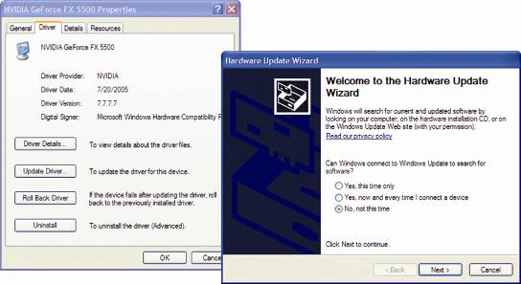
Figure 12-20 Use Device Manager to update drivers for a device

Slide 20
Solving Hardware Problems Using Windows 2000/XP (continued)
Verify that drivers are certified by Microsoft
Use the File Signature Verification tool (Sigverif.exe)
Use the Driver Query tool (Driverquery/si > myfile.txt)
Use the Device Manager (Driver Details)
How to control OS response to an unsigned driver
Open the System Properties window
Click the Hardware tab to open Driver Signing Options
Select how Windows should handle driver installation

Slide 21
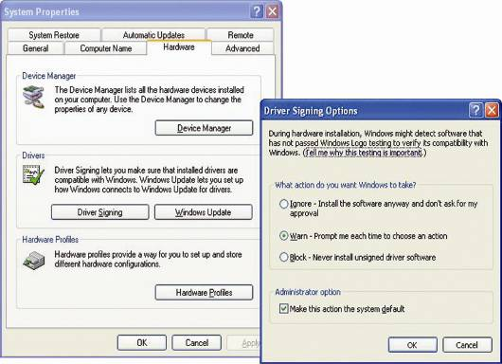
Figure 12-22 Tell Windows how you want it to handle installing an unsigned driver

Slide 22
Installing and Supporting Applications
Two methods:
Use the Add or Remove Program applet
Run the application’s setup program
How to troubleshoot malfunctioning legacy software
Check the Microsoft Web site for updates
Check the Manufacturer’s Web site for updates/advice
Consider upgrading the software to a later version
Use the Windows XP Compatibility Mode utility
Compatibility Mode utility emulates native OS of program
Can be set in Properties dialog box of shortcut menu

Slide 23
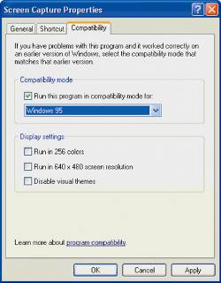
Figure 12-25 Setting Windows XP to run a legacy program in compatibility mode

Slide 24
Installing and Supporting Applications (continued)
How to solve problems with applications
Use the Error Reporting service or Dr. Watson
Try a reboot
Scan for viruses
Run Windows Update
Free up system resources
Uninstall and reinstall the application
Run or install application under another user account
Create a new data file
Try restoring default settings

Slide 25
Tools Useful to Manage Hardware and Applications
Console: window to one or more administrative tools
Snap-in: individual tool placed in a console
Computer Management
Console consolidating several administrative tools
Accessed from Administrative Tools in Control Panel
Two snap-ins: Disk Management and Device Manager
Microsoft Management Console (MMC)
Used to build customized console windows
File saved with .msc extension; e.g. Compmgmt.msc
Administrator privileges are required to use functions

Slide 26
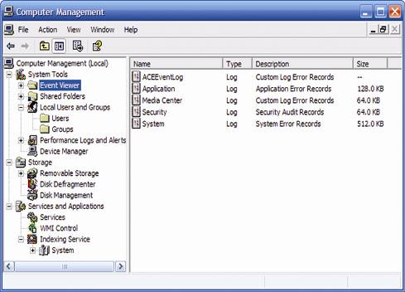
Figure 12-31 Windows 2000/XP Computer Management combines several administrative tools into a single easy-to-access window

Slide 27
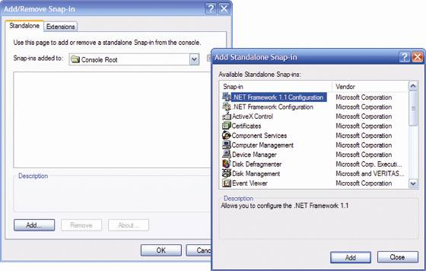
Figure 12-34 The Add/Remove Snap-in window

Slide 28
Tools Useful to Manage Hardware and Applications (continued)
Event Viewer (Eventvwr.msc)
Computer Management console snap-in
Displays logs of significant events; e.g., network failure
Three standard logs: application, security, and system
Event types (non-security): Information, Warning, Error
Events can be filtered via Properties dialog box of log
Log file size can also be limited via Properties
Windows 2000/XP support tools
Located in the \Support\Tools folder on the setup CD
Dependency Walker: list files used by an application

Slide 29
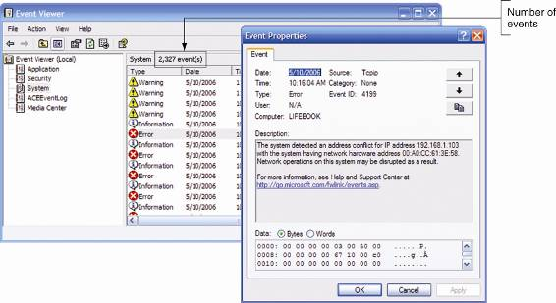
Figure 12-36 Use Event Viewer to see information about events with applications, security, and the system

Slide 30
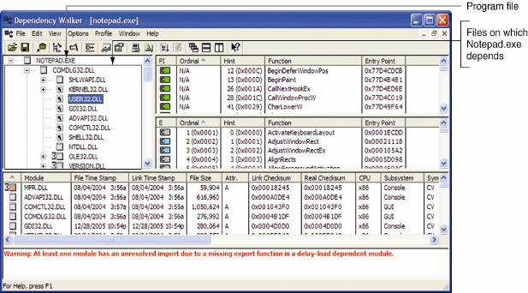
Figure 12-40 Dependency Walker shows files the Notepad.exe program needs to run

Slide 31
Protecting and Maintaining Windows System Files
Tools for protecting and backing up system files:
Windows File Protection
System Restore (Windows XP only)
Backing up the system state
Automated System Recovery (Windows XP only)
System state data: critical files for loading an OS
Types of system state data:
All files necessary to boot the OS
The Windows 2000/XP registry
All system files in the %SystemRoot% folder

Slide 32
Windows File Protection
Protects files from being changed or deleted
Files protected: .sys, .dll, .ttf, .fon, .ocs, or .exe
How Windows Files Protection (WFP) works
Keeps good system files in C:\..\system32\dllcache
System files are tested against copy in dllcache folder
Copy in dllcache folder replaces a questionable file
WFP may request that you insert the setup CD
System File Checker (SFC): tool used by WFP
Checks system files after unattended installation
Verifies that the correct system files are being used

Slide 33
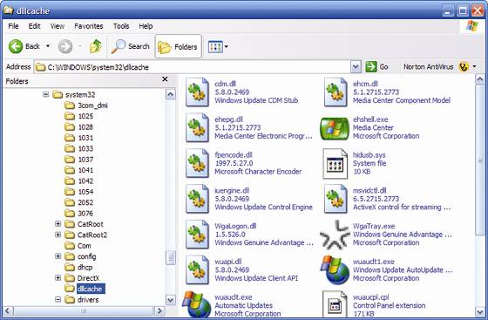
Figure 12-42 Windows File Protection stores good copies of system files in the C:\Windows\system32\dllcache folder

Slide 34
Windows XP System Restore
Restores system to a prior state (restore point)
Restore point: snapshot of the system
Impact of restore process on the system
Does not affect the data on the hard drive
Can affect software, hardware, and various settings
Does not generally help recovery from virus or worm
Ways to create a restore point
By system: when you install new devices or software
By PC technician: whenever circumstance require

Slide 35
Back Up and Restore the System State
Back up the system before making major changes
Enables you to undo changes, if necessary
How to back up the system state
Open up the Backup Utility window
Click the Backup tab
Check the System State box in the list of items
Click Browse to point to where backup will be saved
Choose an appropriate location to save backup files
Click Start Backup to begin the process
Click Start Backup again

Slide 36
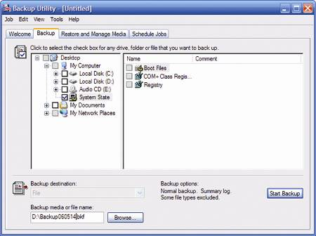
Figure 12-48 Back up the Windows 2000/XP registry and all critical system files

Slide 37
Back Up and Restore the System State (continued)
Restoring the system state restores the registry
How to restore the system state
Launch the Windows Backup tool
Click the Restore and Manage Media tab
Select the backup you want to restore
Select the location to which backup is to be restored
Click the Start Restore button to start the process
Caveat: Windows desktop is needed to use utility

Slide 38
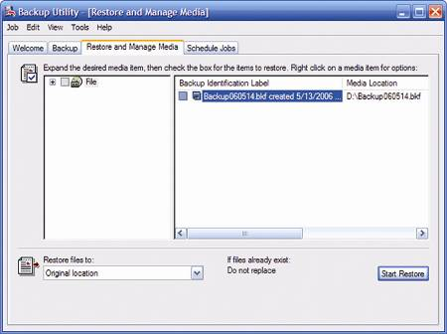
Figure 12-49 Restore the system state from the Restore and Manage Media tab of the Backup dialog box

Slide 39
Windows XP Automated System Recovery
Automated System Recovery (ASR)
Backs up entire drive on which Windows is installed
Recovery does not include changes since backup
Creating the ASR backup and ASR disk
Open the Backup or Restore Wizard
Click Advanced Mode to open Backup Utility
Click Automated System Recovery Wizard
Click Next to open Backup Destination
Select location to store backup files
Click Finish to create backup and ASR disk

Slide 40
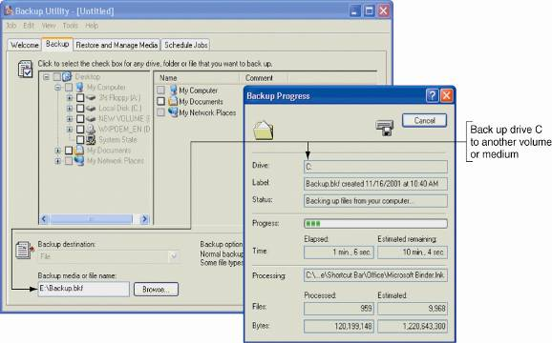
Figure 12-51 The Backup utility can create a backup of drive C and an ASR disk to be used later for the Automated System Recovery utility

Slide 41
Windows XP Automated System Recovery (continued)
Restoring the system using an ASR backup
Boot the system from the Windows XP CD
Press F6 if your system uses RAID or SCSI
Press F2 to start the ASR process
Insert the ASR floppy disk
From this point, Windows XP Setup manages recovery
Planning ahead for Automated System Recovery
Create a partition for the OS and software (drive C)
Use a second partition for user data (drive D)
Backup drive C using ASR, backup D using Ntbackup

Slide 42
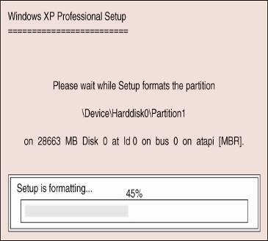
Figure 12-53 As part of the Automatic System Recovery process, Windows XP Setup repartitions and reformats the volume holding Windows XP

Slide 43
The Windows 2000/XP Registry
Hierarchical database containing system information
Most system components depend on the Registry
PC technicians should be familiar with the Registry
It may be necessary to manually edit the Registry

Slide 44
Table 12-4 Components that use the Windows 2000/XP registry

Slide 45
How the Registry is Organized
Windows Registry Editor: used to view/edit registry
Logical organization
Inverted tree with Windows Registry at root
Six branches (keys); e.g., HKEY_LOCAL_MACHINE
Subkeys hold other subkeys or values
Physical organization
Differs significantly from the logical organization
Registry is stored in five files called hives
HKEY_PERFORMANCE_DATA does not use a hive
Hives are stored in %SystemRoot%\system32\config

Slide 46
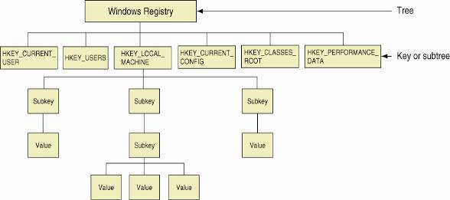
Figure 12-54 The Windows 2000/XP registry is logically organized in an upside-down tree structure of keys, subkeys, and values

Slide 47
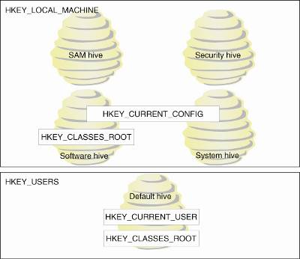
Figure 12-56 The relationship between registry subtrees (keys) and hives

Slide 48
Backing Up and Recovering the Registry
Choices: back up system state or individual keys
Back up the registry by backing up the system state
Backup Utility copies files to one of two locations
Restore registry using Ntbackup
Also restore registry by copying files to C:\..\config
Backing up individual keys in the registry
Open the registry editor
Select desired key
Export the key to a desired location

Slide 49
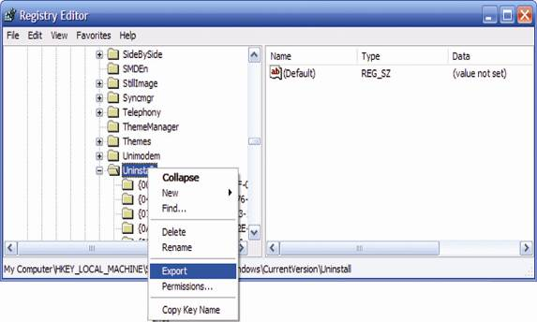
Figure 12-57 Using the Windows XP registry editor, you can back up a key and its subkeys using the Export command

Slide 50
Editing the Registry
One of the reasons for editing the registry
Remove entries remaining after application uninstalled
Windows XP has a single registry editor: Regedit.exe
Windows 2000 has two registry editors
Editing the registry to change name of Recycle Bin
Open the Registry Editor
Locate subkey for Recyle Bin (under HKCU)
Export current key to Desktop for backup purposes
Double-click (Default), the name of the value
Enter a new name, such as “Jean’s Trash Can”

Slide 51
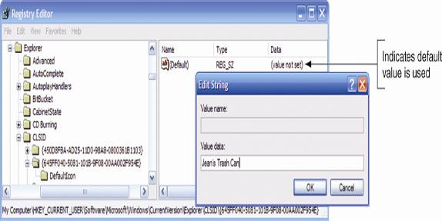
Figure 12-60 Editing a registry subkey value

Slide 52
Optimizing the Windows 2000/XP Environment
Create procedures to backup the system and data
Provide for scheduled downloads of updates
Protect system with firewall and antivirus software
Create user accounts with limited set of privileges
Run only needed services and optimize memory

Slide 53
Tools to Manage Software
Task Manager
Used to view running process and performance data
Accessed in three ways; e.g., press Ctrl+Alt+Delete
Five tabs in Windows XP (three tabs in Windows 2000)
Applications: displays running applications
Processes: lists system services and other processes
Performance: provides details about resource usage
Networking: monitors network activity and bandwidth
Users: indicates current users on the system
Use tools to diagnose and solve performance issues
Example: close unneeded services via Processes tab

Slide 54
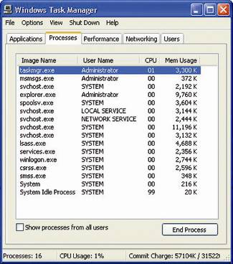
Figure 12-62 This Processes tab of Task Manager shows Windows processes running
in the background of a barebones Windows XP system

Slide 55
Tools to Manage Software (continued)
System Configuration Utility (MSCONFIG)
Identifies processes launched at startup
Used to temporarily disable a process from loading
Not available in Windows 2000 (use third-party utility)
To use Msconfig, enter msconfig.exe in the Run dialog
Services Console
Controls installed Windows and third-party services
To launch console, enter Services.msc in Run dialog
Types of services: Automatic, Manual, Disabled
Properties dialog of a service provides more details

Slide 56
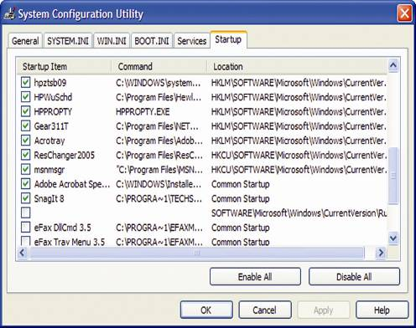
Figure 12-71 Control startup items on the Startup tab of Msconfig

Slide 57
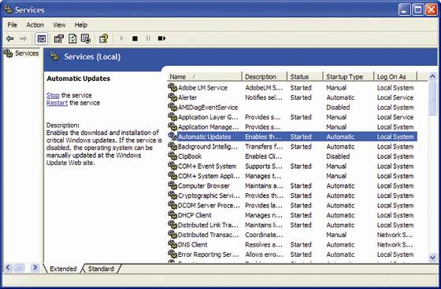
Figure 12-72 The Services window is used to manage Windows services

Slide 58
Uninstall Unwanted Software
Using the Add or Remove Programs applet
Access the applet in the Control Panel
Select the hardware device or application
Click Change/Remove and follow directions onscreen
Uninstall routine
Second removal choice after Add or Remove Programs
Example: WinPatrol application includes this routine
Delete program files
Third removal choice
Files are usually located in C:\Program Files

Slide 59
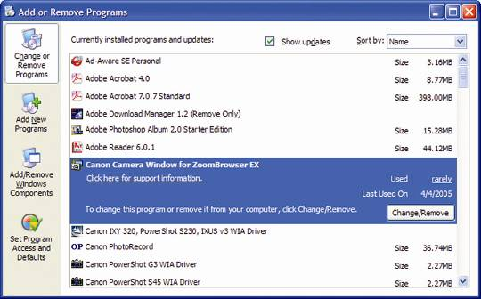
Figure 12-74 Use the Add or Remove Programs applet to uninstall a few hardware devices and most applications

Slide 60
Uninstall Unwanted Software (continued)
Delete registry entries
Open the Registry Editor
Locate the Uninstall key to the Windows desktop
Backup the Uninstall key, save it to Desktop
Locate file to delete (dependent on the Uninstall key)
Delete the targeted file
Open Add or Remove Programs to verify deletion
If the program list is not correct, restore the Uninstall key
If program list is correct, delete backup to Uninstall key
Restart the PC and troubleshoot any startup errors

Slide 61
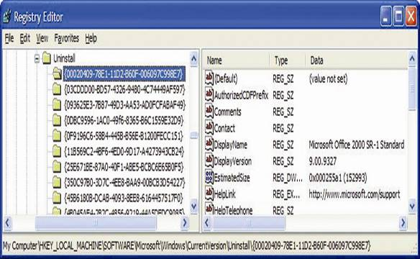
Figure 12-78 Select a subkey under the Uninstall key to display its values and data in the right pane

Slide 62
Managing Windows 2000/XP Memory
Virtual Memory Manager (VMM)
Interface between software and physical/virtual memory
Provides a set of memory addresses to each program
Memory is allocated in 4KB segments (pages)
Pages are stored in RAM or swap file on hard drive
Some guidelines for managing memory
If drive space is limited, limit maximum size of page file
If RAM space is limited, expand page file size to 4 GB
Spread page file over several physical devices
Do not completely eliminate virtual memory

Slide 63
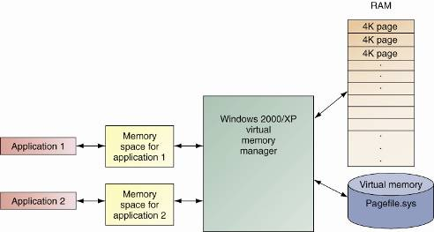
Figure 12-80 Windows 2000/XP memory management

Slide 64
Summary
Administrator privileges are generally required to install hardware and software
Disk Management utility: partition/format hard drive
Console: window with administrative tools (snap-ins)
Microsoft Management Console (MMC): build customized console windows
Windows File Protection: protects system files from inadvertent changes or deletions

Slide 65
Summary (continued)
System Restore utility: returns system to earlier state
Two backup tools: Backup Utility and Automated System Recovery (ASR)
Windows registry: hierarchical database storing all information about system components
Tools to manage software: Task Manager, System Configuration Utility, and the Services console
Virtual Memory Manager (VMM): manage physical and virtual memory

